Slide 1
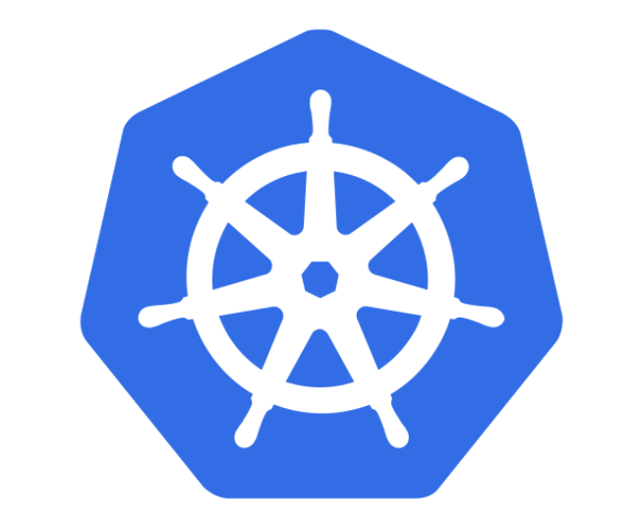
Kubernetes (K8s)
Introduction ➡️ Deep Dive
Ravindu Nirmal Fernando | SLIIT | February 2025
https://ravindunfernando.com

Slide 2
How can we run containers at scale?

Slide 3
Container orchestration
Container orchestration automates the deployment, management, scaling, and networking of containers.
Container orchestration can be used in any environment where you use containers. It can help you to deploy the same application across different environments without needing to redesign it.

Slide 4
What is Kubernetes?
“Kubernetes (k8s) is an open source platform for automating deployment, scaling and management of containers at scale”
Project that was created by Google as an open source container orchestration platform. Born from the lessons learned and experiences in running projects like Borg and Omega @ Google
It was donated to CNCF (Cloud Native Computing Foundation) who now manages the Kubernetes project
Current Kubernetes stable version – 1.32

Slide 5
K8s Components & Architecture
K8s itself follows a client-server architecture with a master and worker nodes.
<Worker Node 1>
<docker>
<Worker Node 2>
<docker>
CLI
<kubectl>
<Master Node>
<Worker Node 3>
User
<docker>
Notes:
The master server consists of various components including a
API server contains various methods to directly access the Kubernetes
Scheduler assigns to each worker node an application
Controller manager
3a) Keeps track of worker nodes
3b) Handles node failures and replicates if needed
3c) Provide endpoints to access the application from the outside world
4) Cloud controller communicates with cloud provide regarding resources such as nodes and IP addresses
5) Etcd works as backend for service discovery that stores the cluster’s state and its configuration
A worker node consists of:
1) Container runtime that pulls a specified Docker image and deploys it on a worker node
2) Kubelet talks to the API server and manages containers on its node
3) Kube-proxy load-balances network traffic between application components and the outside world

Slide 6
K8s Components & Architecture <cont>
<Master Node>
The master node has:
API server contains various methods to directly access the Kubernetes
etcd works as backend for service discovery that stores the cluster’s state and its configuration
CLI
<kubectl>
API server
<kube-apiserver>
User
etcd

Slide 7
K8s Components & Architecture <cont>
<Master Node>
controller manager
scheduler
Scheduler assigns to each worker node an application
Controller manager:
Keeps track of worker nodes
Handles node failures and replicates if needed
Provide endpoints to access the application from the outside world
CLI
<kubectl>
API server
<kube-apiserver>
User
etcd

Slide 8
K8s Components & Architecture <cont>
<Master Node>
cloud-controller manager
cloud provider API
controller manager
scheduler
Cloud controller communicates with cloud provide regarding resources such as nodes and IP addresses
CLI
<kubectl>
API server
<kube-apiserver>
User
etcd

Slide 9
K8s Components & Architecture <cont>
<Master Node>
cloud-controller manager
cloud provider API
controller manager
scheduler
<Worker Node x>
<docker>
pod 1
pod 2
CLI
<kubectl>
API server
<kube-apiserver>
container 1
container 1
kubelet
container 2
container 2
container n
container n
User
etcd
The worker node consists of:
Kubelet talks to the API server and manages containers on its node

Slide 10
K8s Components & Architecture <cont>
<Master Node>
cloud-controller manager
cloud provider API
controller manager
scheduler
<Worker Node x>
<docker>
kube-proxy
pod 1
pod 2
CLI
<kubectl>
API server
<kube-apiserver>
container 1
container 1
kubelet
container 2
container 2
container n
container n
Maggie
etcd
Kube-proxy load-balances network traffic between application components and the outside world

Slide 11
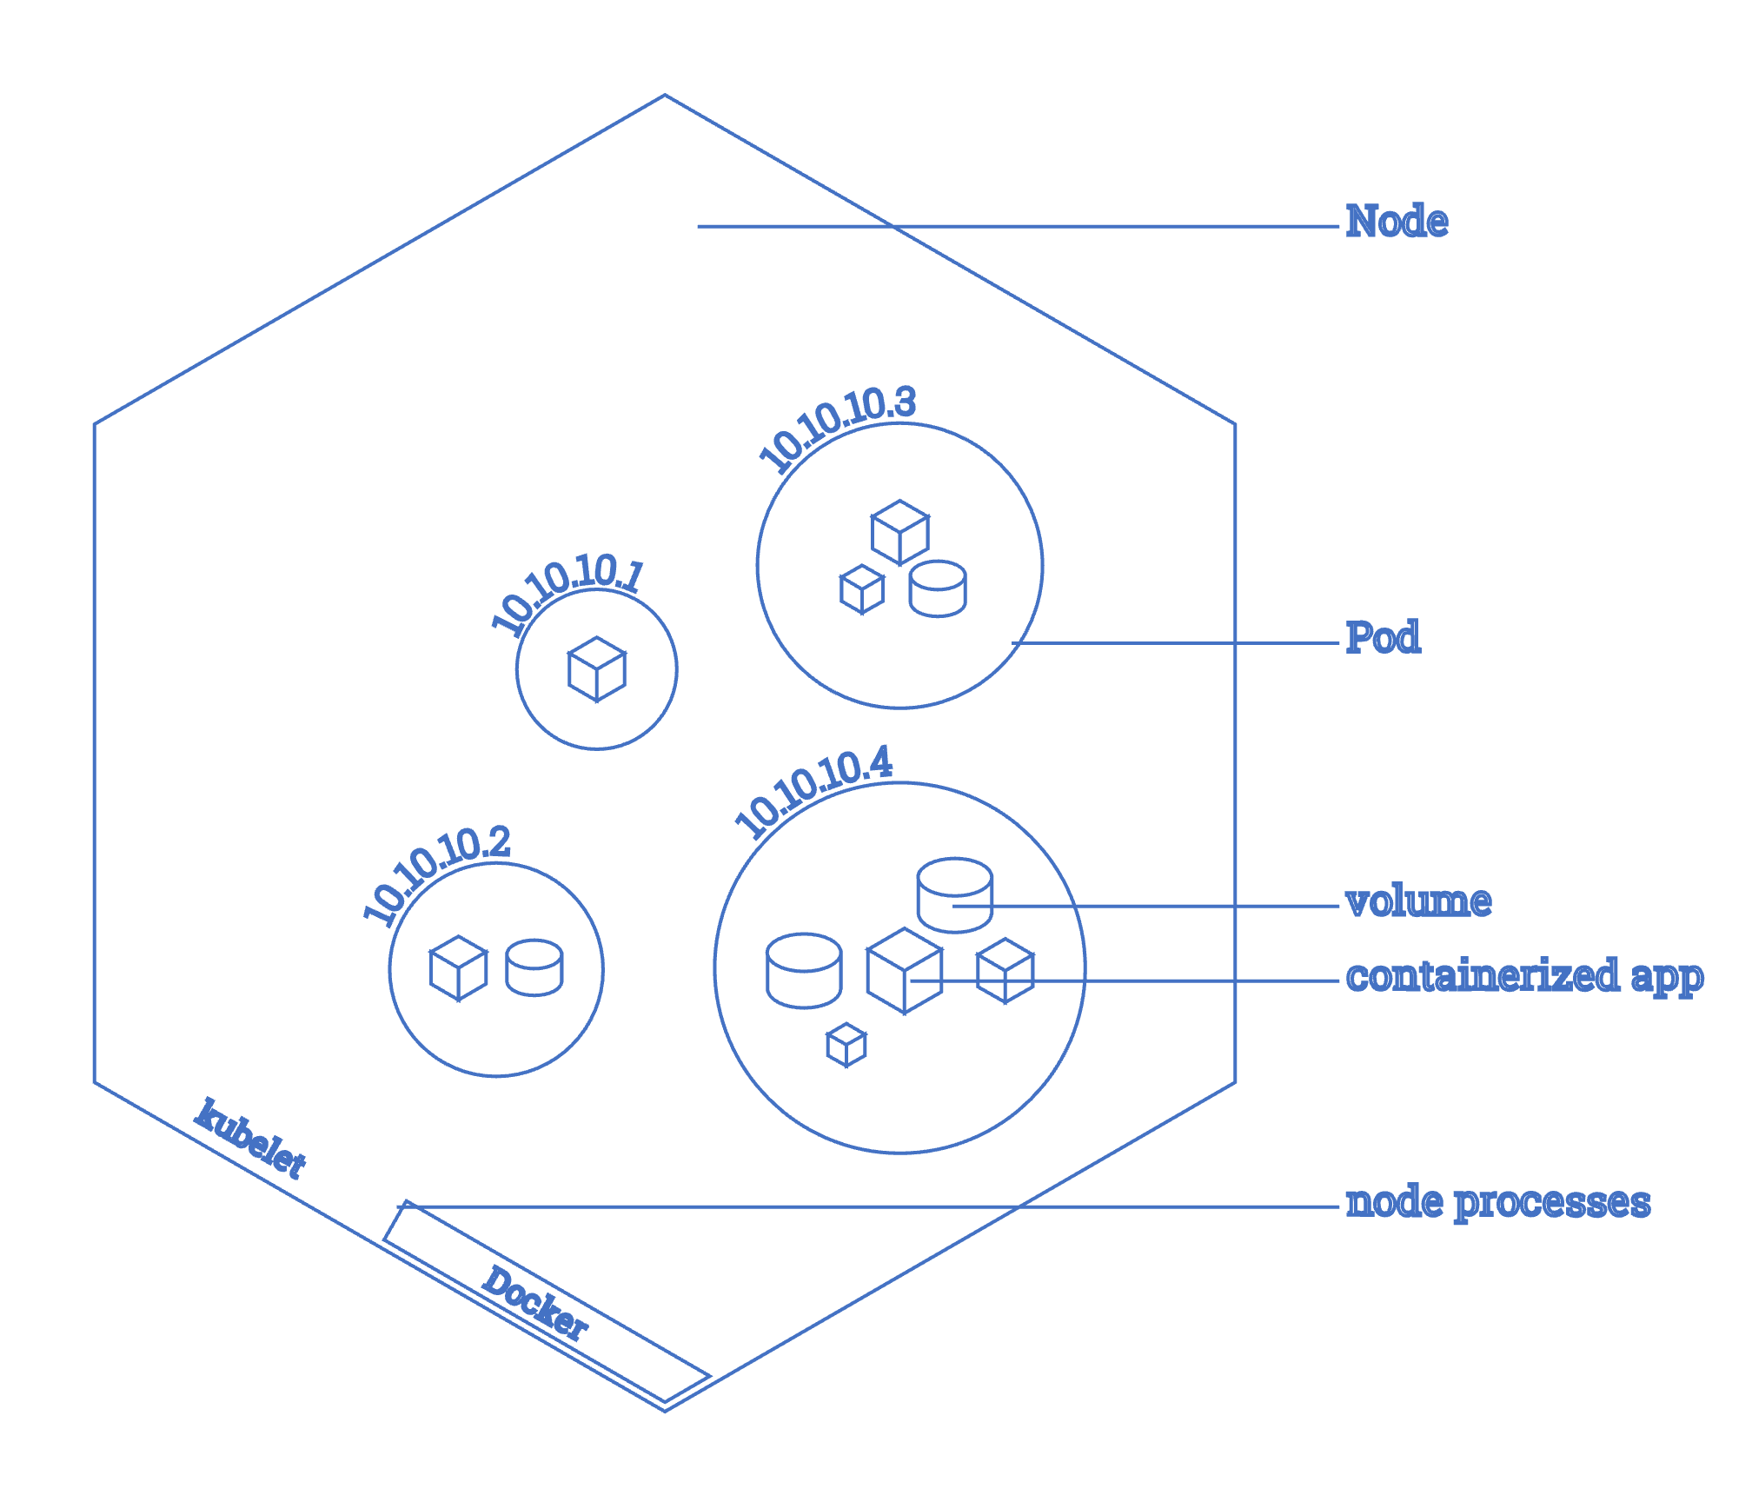
Basic building blocks
Containers
Define single running process*
E.g. docker container
Pods
the way of running containers in Kubernetes
basic deployable and scaling unit
defines one or more containers
containers are co-located on a node
flat network structure
Nodes:
physical worker machines
can run multiple pods
pods running within single node don’t know about each other

Slide 12
Running things locally
Minikube:
single node cluster
running in a VM
supports linux, windows and macOS
mature project
Docker Desktop with built-in kubernetes:
single node cluster
running in a VM
windows and macOS
drag & drop installation
bound to specific kubernetes version
kind:
Requires you to have Docker or Podman installed in your local computer
https://kubernetes.io/docs/tasks/tools/

Slide 13
Managing cluster resources
Create resource from file - kubectl create -f resource_file.yml
Change existing (or create) resource based on file - kubectl apply -f resource_file.yml
Delete existing resource - kubectl delete resource_type resource_name
List resources of type - kubectl get resource_type
Edit resource on the server - kubectl edit resource_type resource_name

Slide 14
Debugging cluster resources
Execute command on the container - kubectl exec [-it] pod_name process_to_run
Get container logs - kubectl logs pod_name [-c container_name]
Forward port from a pod - kubectl port-forward pod_name local_port:remote_port
Print detailed description of a resource - kubectl describe resource_type resource_name

Slide 15
Few resource objects in K8s
Replica Sets - Ensures desired number of pods exist by: scaling up or down and running new pods when nodes fail
Deployment
A Deployment provides declarative updates for Pods and ReplicaSets. You describe a desired state in a Deployment, and the Deployment Controller changes the actual state to the desired state at a controlled rate.
Service
A method for exposing a network application that is running as one or more Pods in your cluster.
Cluster IP/ NodePort/ Load Balancer
Notes:
Cluster IP - ClusterIP is the default service that enables the communication of multiple pods within the cluster. By default, your service will be exposed on a ClusterIP if you don't manually define it. ClusterIP can’t be accessed from the outside world. But, a Kubernetes proxy can be used to access your services.
NodePort - simply routes traffic on a random port on the host to a random port on the container.
LoadBalancer - It is a standard load balancer service that runs on each pod and establishes a connection to the outside world, either to networks like the Internet, or within your datacenter. The LoadBalancer will keep connections open to pods that are up, and close connections to those that are down. This is similar to what you have on AWS with ELBs, or Azure with Application Gateway. Upstreams provide Layer 4 routing for HTTP(S) traffic, whereas Downstreams provide Layer 7 routing for HTTP(S) traffic.

Slide 16
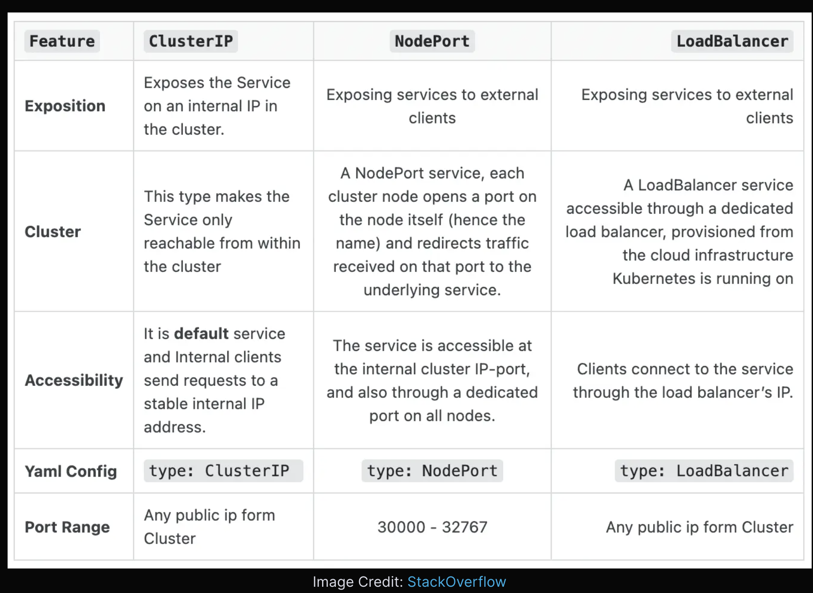
Notes:
Cluster IP - ClusterIP is the default service that enables the communication of multiple pods within the cluster. By default, your service will be exposed on a ClusterIP if you don't manually define it. ClusterIP can’t be accessed from the outside world. But, a Kubernetes proxy can be used to access your services.
NodePort - simply routes traffic on a random port on the host to a random port on the container.
LoadBalancer - It is a standard load balancer service that runs on each pod and establishes a connection to the outside world, either to networks like the Internet, or within your datacenter. The LoadBalancer will keep connections open to pods that are up, and close connections to those that are down. This is similar to what you have on AWS with ELBs, or Azure with Application Gateway. Upstreams provide Layer 4 routing for HTTP(S) traffic, whereas Downstreams provide Layer 7 routing for HTTP(S) traffic.

Slide 17
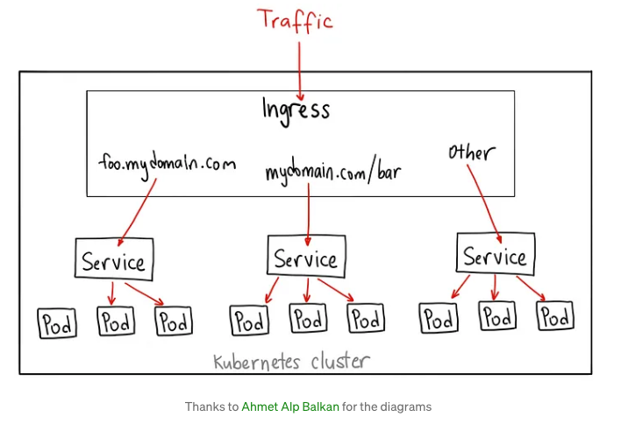
Few resource objects in K8s
Ingress - An Ingress is a Kubernetes object that sits in front of multiple services and acts as an intelligent router. It defines how external traffic can reach the cluster services, and it configures a set of rules to allow inbound connections to reach the services on the cluster.
Notes:
Cluster IP - ClusterIP is the default service that enables the communication of multiple pods within the cluster. By default, your service will be exposed on a ClusterIP if you don't manually define it. ClusterIP can’t be accessed from the outside world. But, a Kubernetes proxy can be used to access your services.
NodePort - simply routes traffic on a random port on the host to a random port on the container.
LoadBalancer - It is a standard load balancer service that runs on each pod and establishes a connection to the outside world, either to networks like the Internet, or within your datacenter. The LoadBalancer will keep connections open to pods that are up, and close connections to those that are down. This is similar to what you have on AWS with ELBs, or Azure with Application Gateway. Upstreams provide Layer 4 routing for HTTP(S) traffic, whereas Downstreams provide Layer 7 routing for HTTP(S) traffic.

Slide 18
Demo
Defining a Pod
Creating a ReplicaSet
Creating a Deployment
Creating a Service and exposing it

Slide 19
I want to be able to deploy and share my app everywhere consistently, and manage it as a single entity regardless of the different parts.
Reference - https://github.com/IBM/helm101/tree/master

Slide 20
Deploying an App – kubectl Way
Let’s see what it takes to deploy an app on a running Kubernetes cluster
There will be lot’s of YAML Kubernetes manifest files
Ex:-
Application deployment and service configuration
Redis master deployment and service configuration
Redis slaves deployment and service configuration
Using the Kubernetes client, kubectl
Create Deployment
Manage Deployment
Refer - https://github.com/IBM/guestbook/tree/master/v1
Reference - https://github.com/IBM/helm101/tree/master

Slide 21
Deploying an App – kubectl Way – Pain Points
CI/CD pipeline
kubectl deployments are not easy to configure, update and rollback
Deploying app to dev/test/production may require different configuration
Update deployment e.g. update with a new image
Change the configuration based on certain conditions
A different serviceType is needed in different environments (e.g. NodePort/LoadBalancer)
Need for rollback
Need of having multiple deployments (e.g. multiple Redis deployments)
Requires to track your deployment and modify YAML files (can be error prone)
Does not allow multiple deployments without updating metadata in manifest files
Share your deployment configurations with your friend, team or customer?
You need to share many files and related dependencies
Your users are required to have knowledge of deployment configuration
Reference - https://github.com/IBM/helm101/tree/master

Slide 22
Here Comes Helm
Deploying an app – Helm Way
No expertise of Kubernetes deployment needed as Helm hides Kubernetes domain complexities
Helm packages all dependencies
Helm tracks deployment making it easy to update and rollback
Same workload can be deployed multiple times
Helm allows assigning workload release names at runtime
Easy to share
Reference - https://github.com/IBM/helm101/tree/master
Notes:
This slides shows how Helm addresses the pain points of deploying via Kubectl discussed in the previously.

Slide 23

What is Helm?
Helm is a tool that streamlines installation and management of Kubernetes applications
A tool or package manager for the Kubernetes, for deployment and management of applications into a Kubernetes cluster
Helm became a CNCF project in mid 2018
It uses a packaging format called charts
A chart is a collection of files that describe Kubernetes resources
Think of Helm like apt/yum/homebrew for Kubernetes
Helm is available for various operating systems like OSX, Linux and Windows
Run Helm anywhere e.g. laptop, CI/CD etc.
Reference - https://github.com/IBM/helm101/tree/master
Notes:
Let’s talk about what is helm. You can call Helm a tool or package manager for the Kubernetes, for deployment and management of applications into a Kubernetes cluster. The Helm is a all about charts - a chart is a collection of Kubernetes resource definitions along with any dependencies, files containing pre-defined values and definition of Chart itself.

Slide 24
What Helm is NOT
A fully fledged system package manager
A configuration management tool like Chef, puppet etc.
A Kubernetes resource lifecycle controller
Reference - https://github.com/IBM/helm101/tree/master
Notes:
It is important to not overzealously compare Helm to programming language library package managers, as such systems have a fundamentally different goal. Helm fits into such a paradigm, by providing some but not all capabilities of package managers. Helm doesn’t adhere strictly to:
A defined security model (signing, verification, etc)
Management logic??
implement (or make it easy to implement) environment-specific (os, processor, distro) optimizations
Helm is not a configuration management tool (such as Chef or Puppet). Helm does provide certain features of such systems, though. Helm's templating and configuration model is a common feature of configuration managers (and also of package managers).
It does not respond real-time to Kuberenetes resources. Helm does something only when someone invokes it essentially.

Slide 25
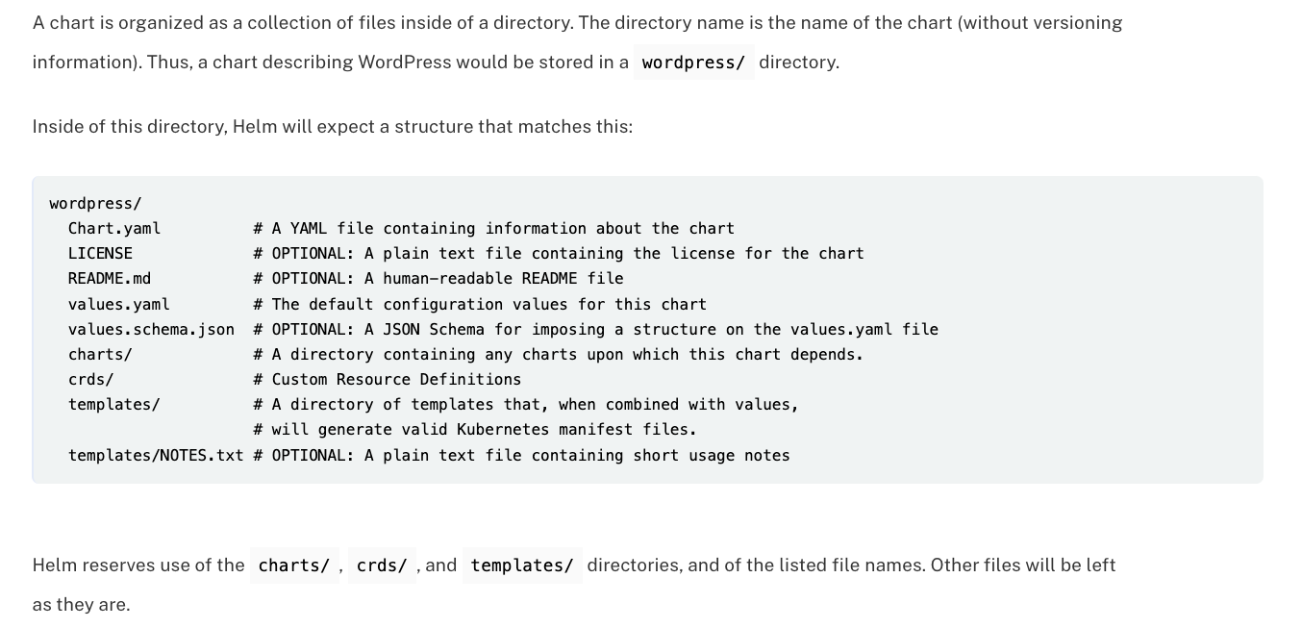
Reference - https://helm.sh/docs/topics/charts/

Slide 26
Demo – Guestbook Chart Deployment
Check existing installation of Helm chart
helm ls
Check what repo do you have
helm repo list
Add repo
helm repo add helm101 https://ibm.github.io/helm101/
Verify that helm101/guestbook is now in your repo
helm repo list
helm search helm101
Install
helm install helm101/guestbook --name myguestbook --set service.type=NodePort – follow the output instructions to see your guestbook application
Verify that your guestbook chart is installed
helm ls
Check chart release history
helm history myguestbook
Reference - https://github.com/IBM/helm101/tree/master
Notes:
Run these commands to deploy guestbook and verify many things as described in the slide.

Slide 27
Demo – Guestbook Upgrades and Rollback
First let’s see what we have
helm history myguestbook
Upgrade
helm upgrade myguestbook helm101/guestbook
helm history myguestbook
Rollback
helm rollback myguestbook 1
helm history myguestbook
Reference - https://github.com/IBM/helm101/tree/master
Notes:
The slide contains commands to upgrade and rollback guestbook deployment, and verification of it.

Slide 28
Demo – Clean Up
Remove repo
helm repo remove helm101
Remove chart completely
helm delete --purge myguestbook
Delete all Kubernetes resources generated when the chart was instantiated
Reference - https://github.com/IBM/helm101/tree/master
Notes:
This slide contains commands to clean up the files and deployment created previously as part of the demo.

Slide 29
Another Demo!!! https://github.com/rav94/devops-in-practice

Slide 30
References
https://kubernetes.io/docs/concepts/overview/components/
https://helm.sh/docs/intro/quickstart/

